Slide 1
BOOTSTRAP
Batch-1:
Aamir Rizwan
Abhishekh Harsh
Abhishekh Sherkar
Aditya Kalhane
Akanksha Mate
Akanksha Sirsat
Akshay Vaidya
Amit Kumar

Slide 2
Introduction to bootstrap
It is a css framework.
Bootstrap makes the web page responsive.
With bootstrap we no need to write seprate css file.
Version:- Bootstrap3, bootstrap4, bootstrap5
What is Framework
Half build solution
Advantages of framework is -
Faster development
Responsive page
Code readibility.

Slide 3
Bootstrap 5 is designed to be responsive to different devices
to ensure proper rendering and touch zooming, add the following <meta> tag inside the <head> element:
<meta name="viewport" content="width=device-width, initial-scale=1">
The width=device-width part sets the width of the page to follow the screen-width of the device.
The initial-scale=1 part sets the initial zoom level when the page is first loaded by the browser.

Slide 4
How to add bootstrap in Html
To add bootstrap in html document we need to add the bootstrap link in the head of the HTML code.
Bootstrap link:-
<link href="https://cdn.jsdelivr.net/npm/bootstrap@5.3.0/dist/css/bootstrap.min.css" rel="stylesheet"> <script src="https://cdn.jsdelivr.net/npm/bootstrap@5.3.0/dist/js/bootstrap.bundle.min.js"></script>
Bootstrap 5 uses JavaScript for different components (like modals, tooltips, popovers etc). However, if you just use the CSS part of Bootstrap, you don't need them.
Eg:
<!DOCTYPE html>
<html lang="en">
<head>
<meta charset="UTF-8">
<meta name="viewport" content="width=device-width, initial-scale=1.0">
<title>Document</title>
<link href="https://cdn.jsdelivr.net/npm/bootstrap@5.3.0/dist/css/bootstrap.min.css" rel="stylesheet">
<script src="https://cdn.jsdelivr.net/npm/bootstrap@5.3.0/dist/js/bootstrap.bundle.min.js"></script>
</head>
<body>
</body>
</html>

Slide 5
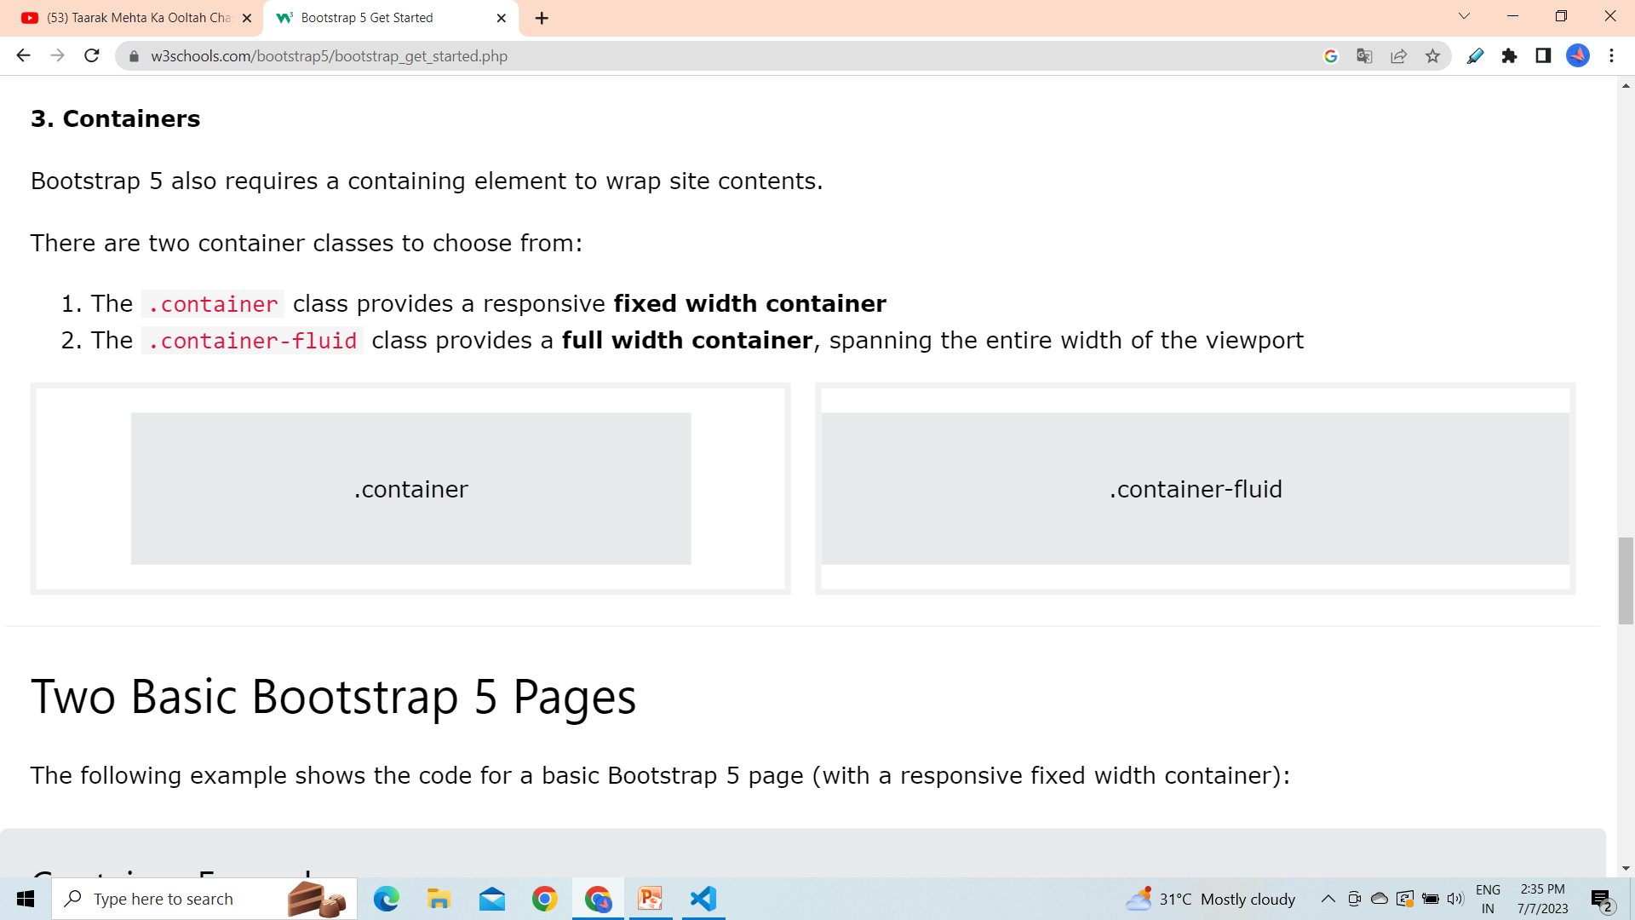
containers
There are two type of containers in the bootstrap, which are container-fluid and container.
container
Eg:
<!DOCTYPE html>
<html lang="en">
<head>
<meta charset="UTF-8">
<meta name="viewport" content="width=device-width, initial-scale=1.0">
<title>Document</title>
<link href="https://cdn.jsdelivr.net/npm/bootstrap@5.3.0/dist/css/bootstrap.min.css" rel="stylesheet">
<script src="https://cdn.jsdelivr.net/npm/bootstrap@5.3.0/dist/js/bootstrap.bundle.min.js"></script>
</head>
<body>
<div class="container">
<h1>My page</h1>
<p>This is paragraph</p>
</div>
</body>
</html>
The .container class provides a responsive fixed width container
This container have some fixed margin and padding.

Slide 6

Container-fluid
Eg:
<!DOCTYPE html>
<html lang="en">
<head>
<meta charset="UTF-8">
<meta name="viewport" content="width=device-width, initial-scale=1.0">
<title>Document</title>
<link href="https://cdn.jsdelivr.net/npm/bootstrap@5.3.0/dist/css/bootstrap.min.css" rel="stylesheet">
<script src="https://cdn.jsdelivr.net/npm/bootstrap@5.3.0/dist/js/bootstrap.bundle.min.js"></script>
</head>
<body>
<div class="container-fluid">
<h1>My page</h1>
<p>This is paragraph</p>
</div>
</body>
</html>
The .container-fluid class provides a full width container, spanning the entire width of the viewport.
It takes whole width of the page.

Slide 7
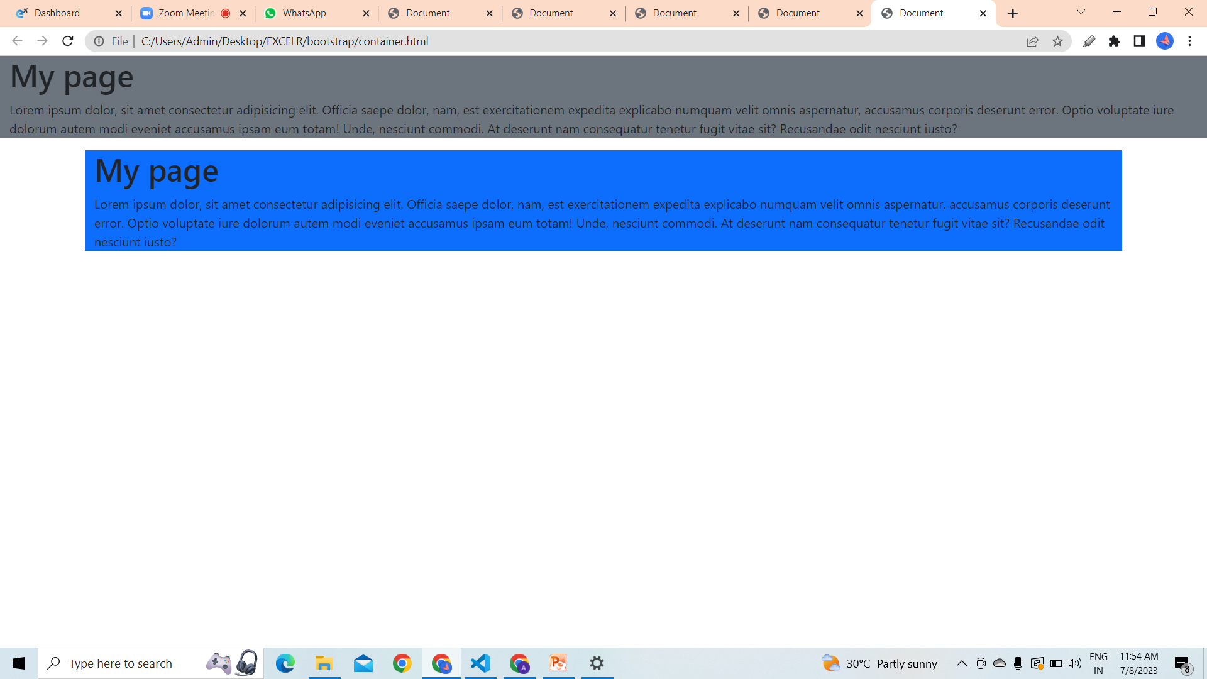

Slide 8
Margin & Padding
In bootstrap there are special class which specifies the margin & padding.
m - for classes that set margin
p - for classes that set padding
t - for classes that set margin-top or padding-top
b - for classes that set margin-bottom or padding-bottom
l - for classes that set margin-left or padding-left
r - for classes that set margin-right or padding-right
Eg:
<body>
<div>
<p class="m-0 p-1 border">padding and no margine</p>
</div>
<div>
<p class="mt-5 ml-5 border">margine top and left</p>
</div>
<div>
<p class="mb-5 p-5 border">margine bottom and padding</p>
</div>
<div>
<p class="mr-5 ml-2 border">margine right and margin left</p>
</div>
</body>
</html>

Slide 9
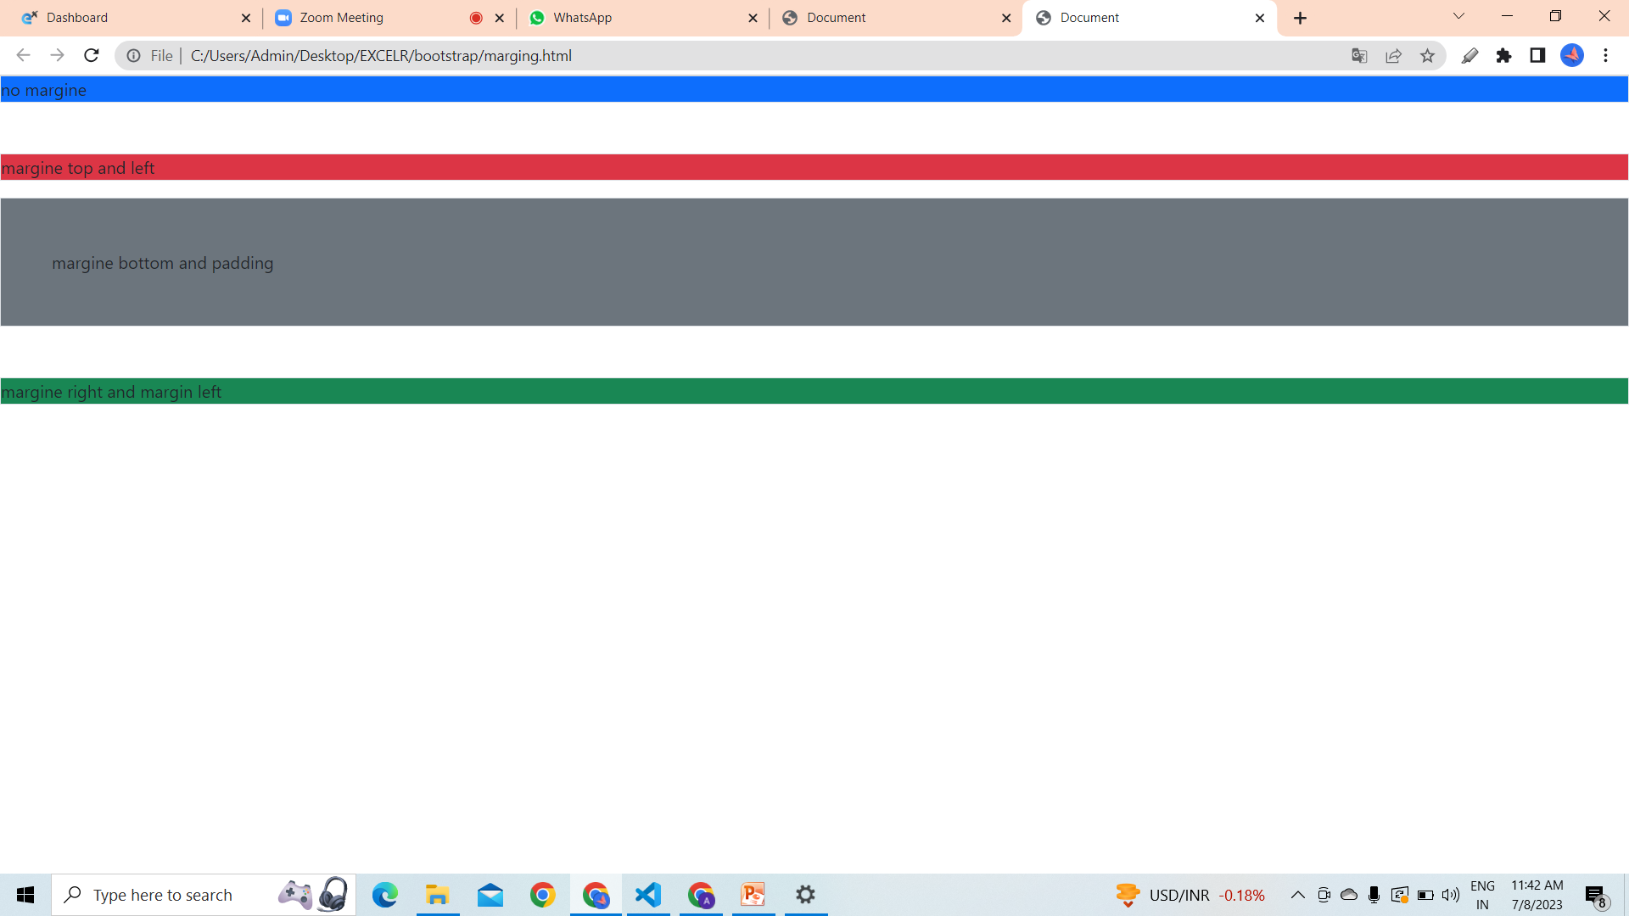

Slide 10
Text Color
In bootstrap there are some specific color used to design the page.
For text we can us text keyword and the color name .
<body>
<p class="text-primary">.textprimary</p>
<p class="text-secondary">.text-secondary</p>
<p class="text-success">.text-success</p>
<p class="text-danger">.text-danger</p>
<p class="text-warning bg-dark">.text-warning</p>
<p class="text-info bg-dark">.text-info</p>
<p class="text-light bg-dark">.text-light</p>
<p class="text-dark">.text-dark</p>
<p class="text-body">.text-body</p>
<p class="text-muted">.text-muted</p>
<p class="text-white bg-dark">.text-white</p>
</body>

Slide 11
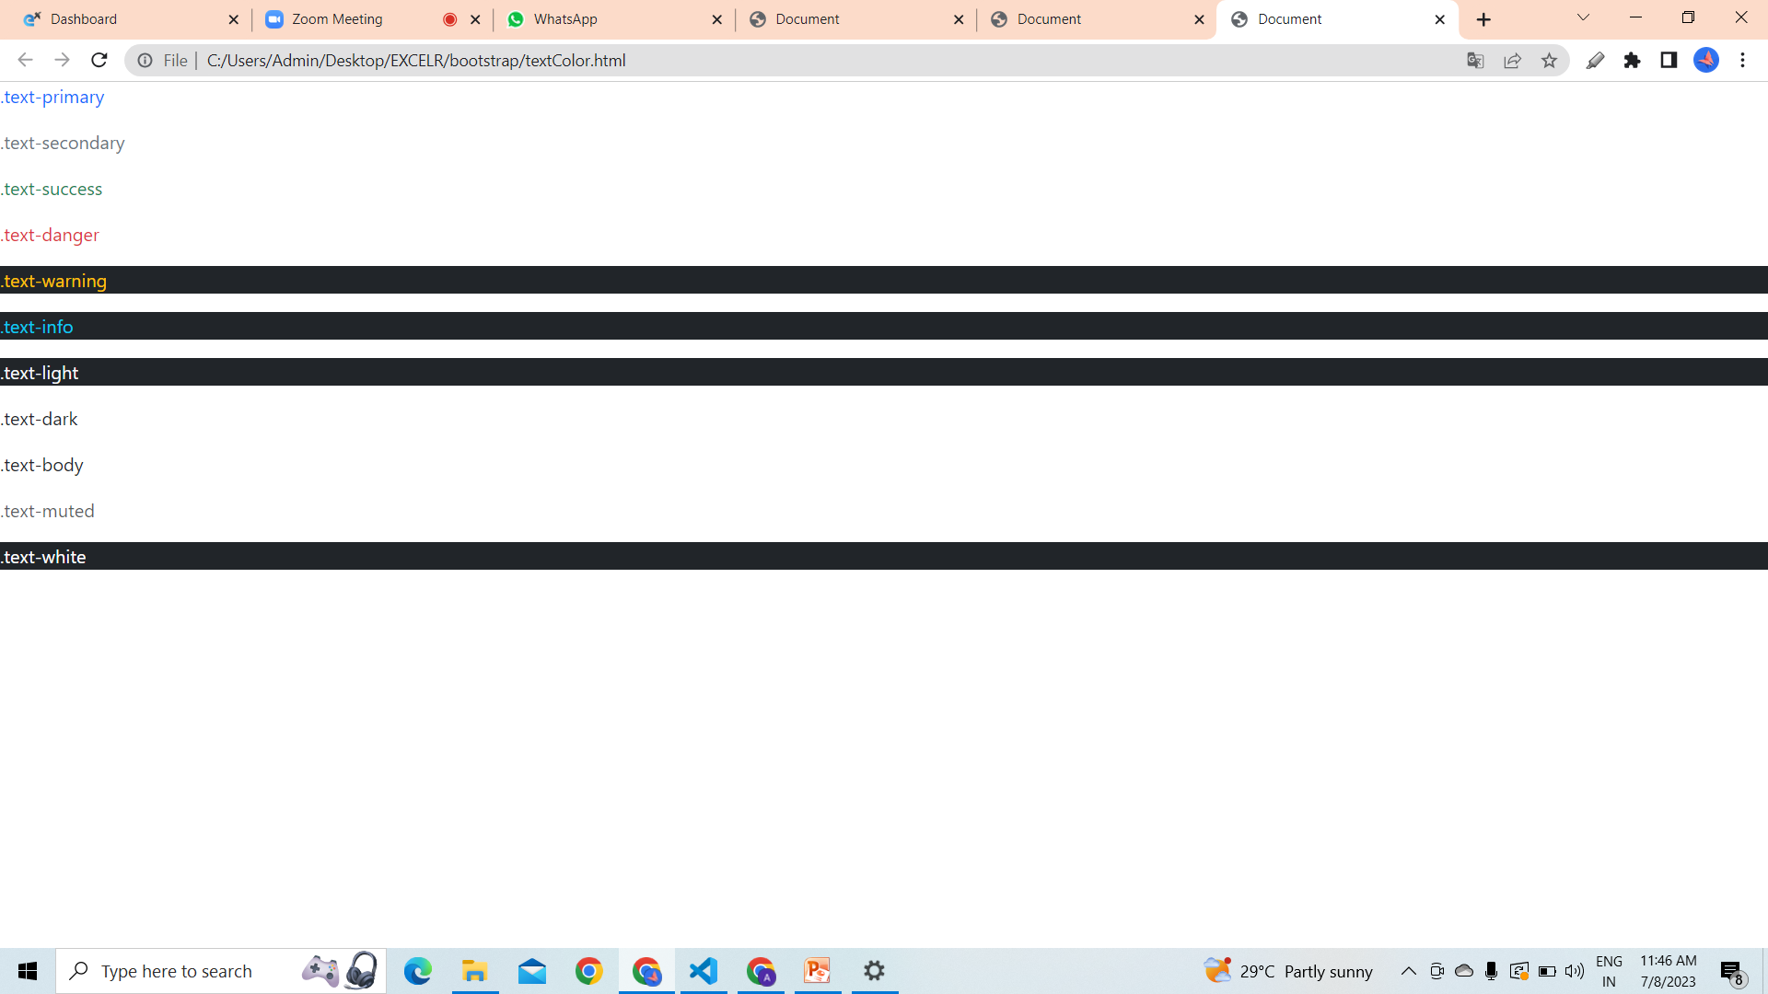

Slide 12
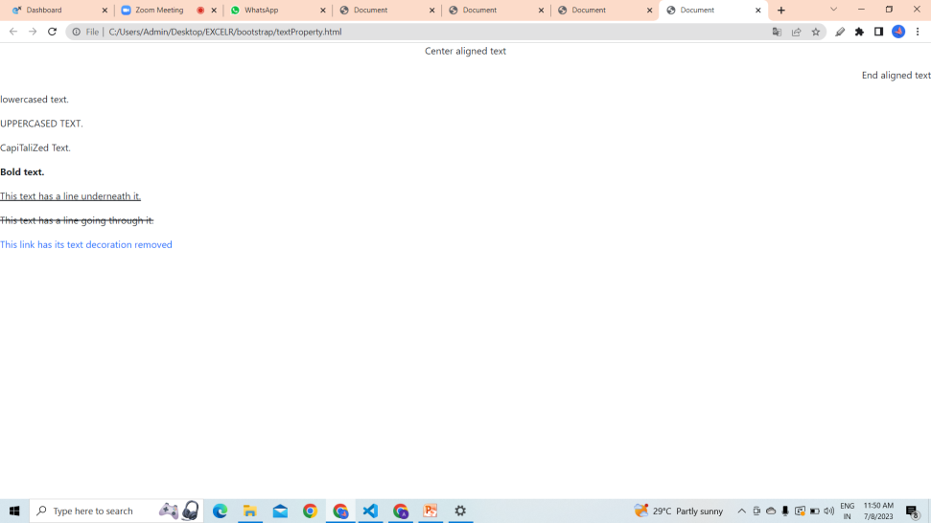
Text property
There are some properties to decorate the text in bootstrap.
Eg:
<body>
<p class="text-primary">.text-primary</p>
<p class="text-secondary">.text-secondary</p>
<p class="text-success">.text-success</p>
<p class="text-danger">.text-danger</p>
<p class="text-warning bg-dark">.text-warning</p>
<p class="text-info bg-dark">.text-info</p>
<p class="text-light bg-dark">.text-light</p>
<p class="text-dark">.text-dark</p>
<p class="text-body">.text-body</p>
<p class="text-muted">.text-muted</p>
<p class="text-white bg-dark">.text-white</p>
</body>

Slide 13
Background color
In bootstrap there are some specific color used to design the page.
For background we can us bg keyword and the color name .
Eg:
<p class="bg-primary">text-primary</p>
<p class="bg-secondary">text-secondary</p>
<p class="bg-success">text-success</p>
<p class="bg-danger">text-danger</p>
<p class="bg-warning bg-dark">text-warning</p>
<p class="bg-info bg-dark">text-info</p>
<p class="bg-light bg-dark">text-light</p>
<p class="bg-dark">text-dark</p>
<p class="bg-body">text-body</p>
<p class="bg-transparent">text-muted</p>
<p class="bg-white">text-white

Slide 14
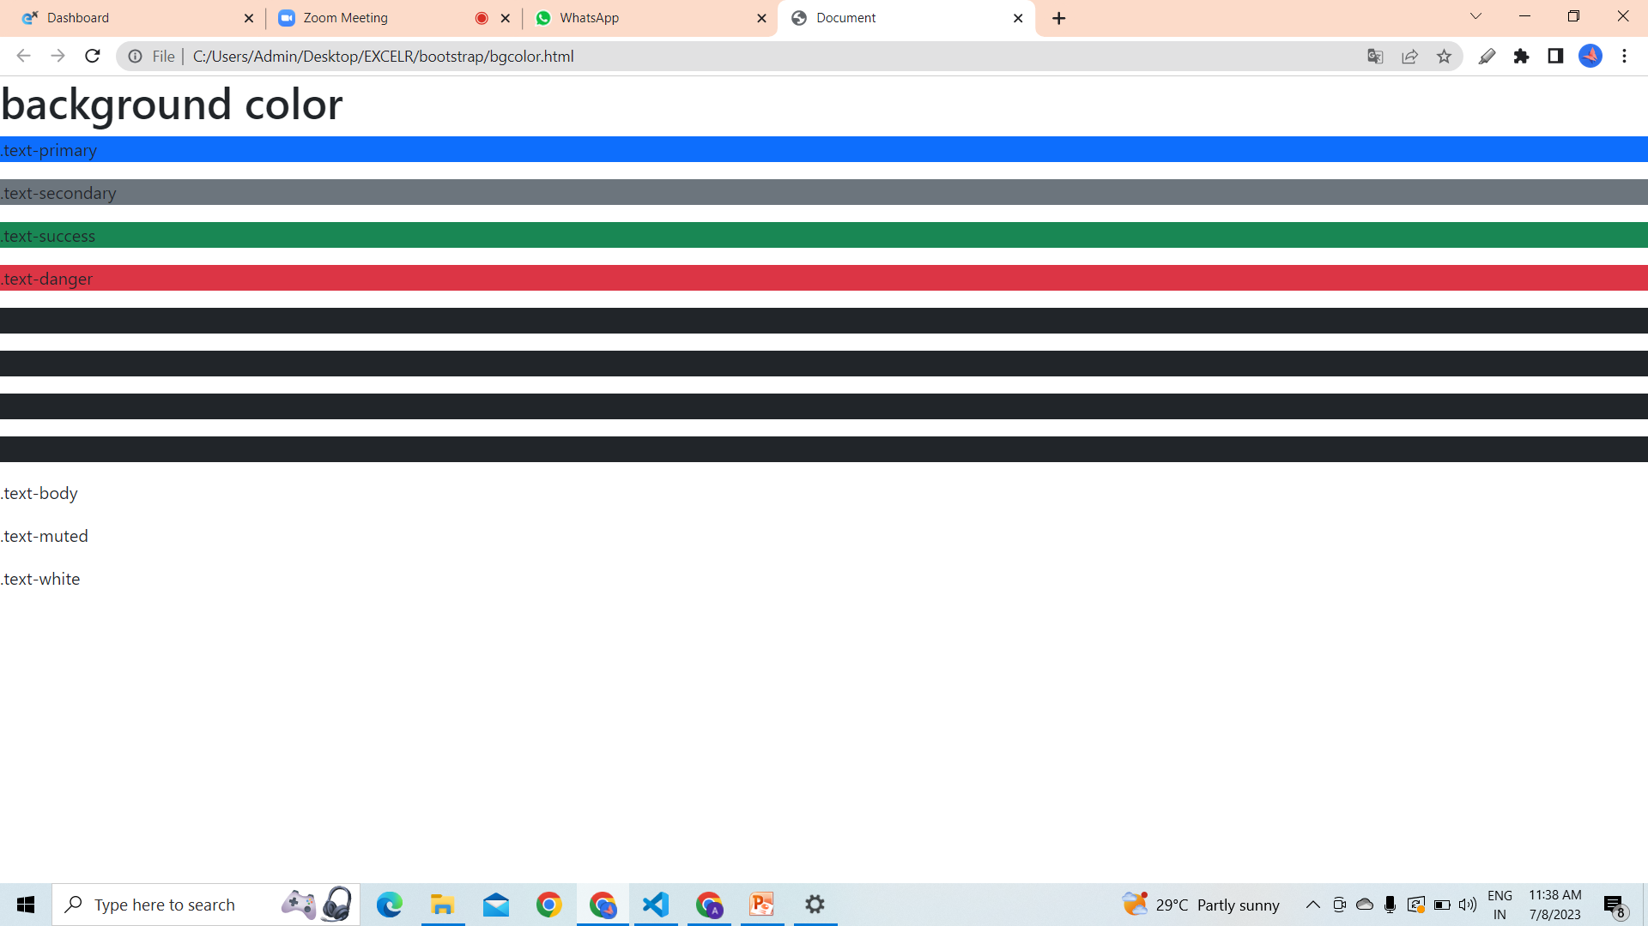

Slide 15
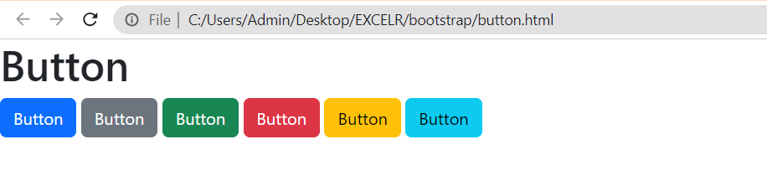
buttons
In bootstrap there are some classes uses for make standard buttons.
<body>
<h1>Button</h1>
<button class="btn btn- primary">Button</button>
<button class="btn btn- secondary">Button</button>
<button class="btn btn- success">Button</button>
<button class="btn btn- danger">Button</button>
<button class="btn btn- warning">Button</button>
<button class="btn btn- info">Button</button>
</body>

Slide 16
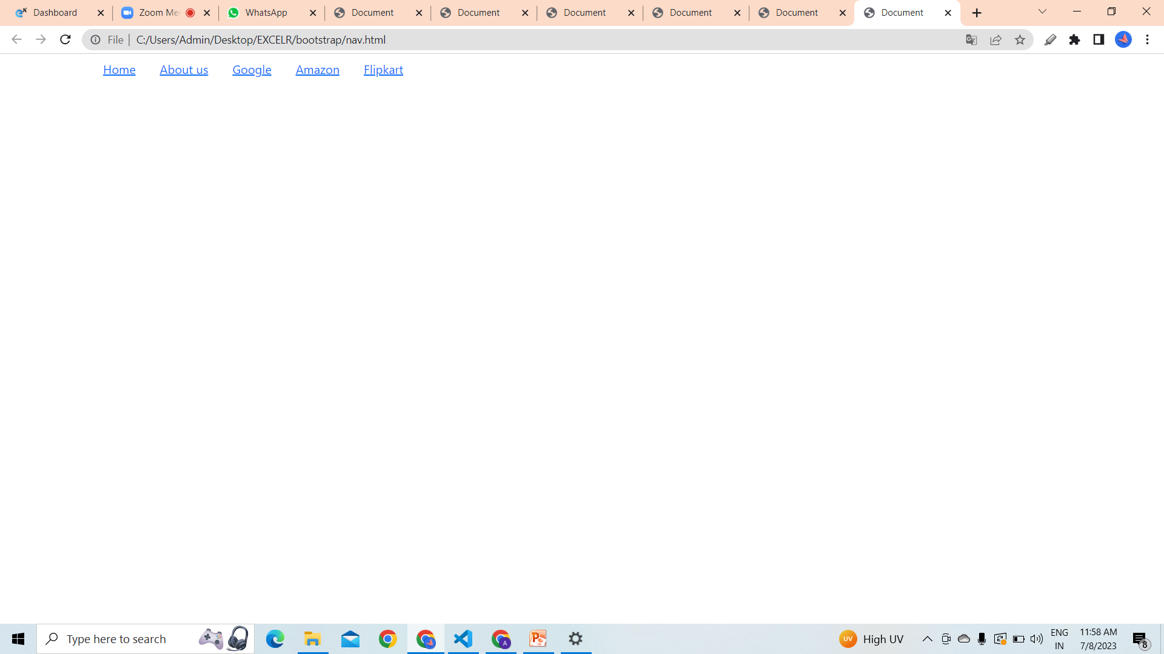
Navigation
Navigation available in Bootstrap share general markup and styles.
The base .nav component is built with flexbox and provide a strong foundation for building all types of navigation components.
body>
<div class="container">
<ul class="nav">
<li class="nav-item">
<a class="nav-link" href="#">About</a>
</li>
<li class="nav-item">
<a class="nav-link" href="#">Home</a>
</li>
<li class="nav-item">
<a class="nav-link" href="#">Google</a>
</li>
<li class="nav-item">
<a class="nav-link" href="#">Amazon</a>
</li>
<li class="nav-item">
<a class="nav-link" href="#">Flipkart</a>
</li>
</ul>
</div>
</body>

Slide 17
Tables
The .table class adds basic styling to a table
The .table-striped class adds zebra-stripes to a table
The .table-bordered class adds borders on all sides of the table and cells
The .table-hover class adds a hover effect (grey background color)
<div class="container mt-3">
<h2>Basic Table</h2>
<p>The .table class adds basic styling (light padding and horizontal dividers) to a table:</p>
<table class="table table-secondary table-hover table-bordered">
<thead class="dark">
<tr>
<th>Firstname</th>
<th>Lastname</th>
<th>Email</th>
</tr>
</thead>
<tbody class="table table-dark">
<tr class="table table-secondary">
<td>John</td>
<td>Doe</td>
<td>john@example.com</td>
</tr>
<tr>
<td>Mary</td>
<td>Moe</td>
<td>mary@example.com</td>
</tr>
<tr>
<td>July</td>
<td>Dooley</td>
<td>july@example.com</td>
</tr>
<tr>
<td>Mary</td>
<td>Moe</td>
<td>mary@example.com</td>
</tr>
</tbody>
</table>
</div>

Slide 18
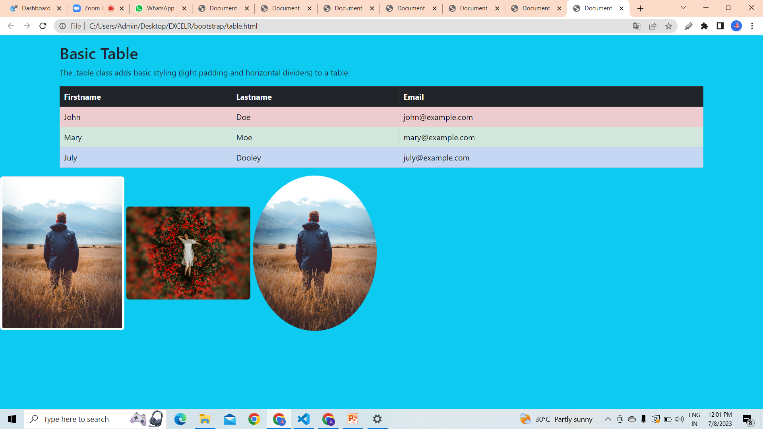

Slide 19
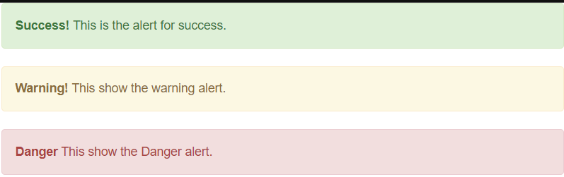
Alerts
In Bootstrap, alerts are used to display important messages or notifications to users.
They are a simple way to highlight and draw attention to information.
Alerts are used to provide an easy way to create predefined alert messages.
Alert adds a style to messages to make them more appealing to the users.
<div class="container">
<div class="alert alert-success">
<strong>Success!</strong> This is the alert for success.
</div>
<div class="alert alert-warning">
<strong>Warning!</strong> This show the warning alert.
</div>
<div class="alert alert-danger">
<strong>Danger</strong> This show the Danger alert.
</div>
</div>

Slide 20
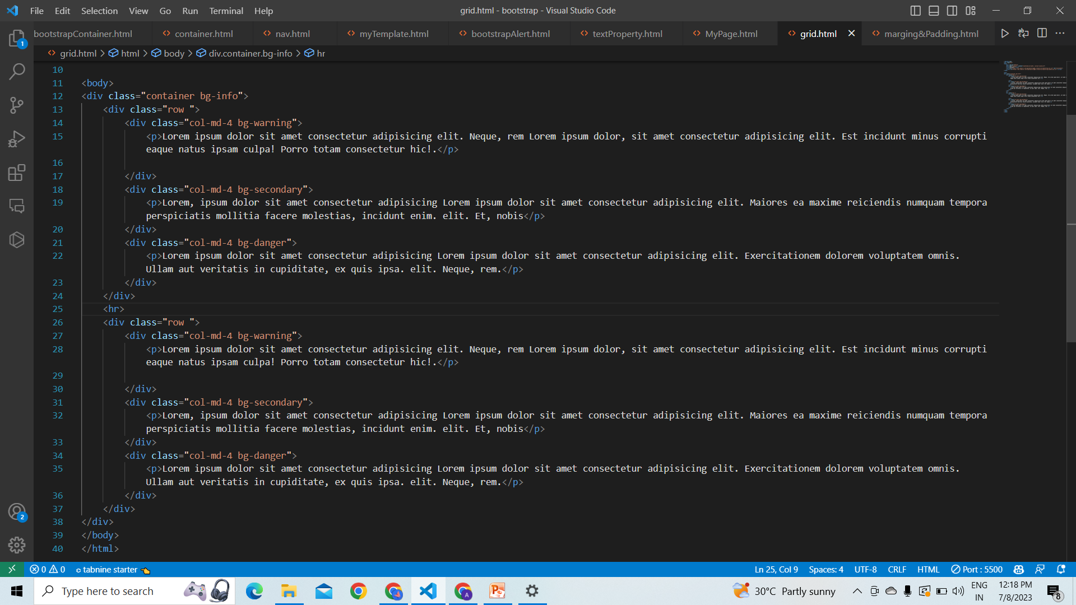
Grid
In Bootstrap, the CSS Grid system is a powerful layout component that allows you to create responsive and flexible grid-based layouts. The grid system in Bootstrap uses a 12-column layout, which you can customize and adjust to suit your needs.

Slide 21
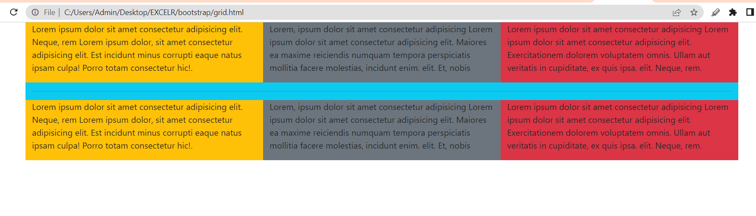

Slide 22
Thank You..!!

